Slide 1
September 16, 2014

Slide 2
Quote of the month:
“I have no doubt that the next generation of American leaders will include a large number of former Boy Scouts.”
Pat Toomey
U.S. Senator for Pennsylvania
Notes:
But of these many programs, one organization holds a special place in my heart: the Boy Scouts of America. Its mission is simple, yet timeless: Prepare young people to make ethical and moral choices over their lifetimes by instilling in them the values of the Scout oath and law.
I love this mission. Not because it’s poetic or grandiose, but because it gets to the heart of what the Boy Scouts set out to accomplish, the shaping of tomorrow’s leaders by building character, and instilling positive values and a sense of responsibility in boys and young men.

Slide 3
COMMISSIONER General Updates

Slide 4
#1 Priority
DC Goals:
29 recruited; need 58
Using Commissioner Report:
31 July, 2014 – Need 39

Slide 5
Journey to Excellence

Slide 8
Annual Service Plan
October
Uniform Inspection (CS & BS)
Commissioner Self-Evaluation
November
Youth Protection Visit
December
Charter Renewal
JTE Measurements
http://commissioner-bsa.org/service.html

Slide 9
Looking Ahead
Save-A-Scout
9

Slide 10
Career Enhancement
The UC does at least two things a month for each unit.
The commissioner attends a unit meeting or unit committee meeting, and stays long enough to evaluate how things are going and to talk with the unit leader. The commissioner should be sure to ask how things are going and how they can help.
The commissioner calls each unit leader between visits to see if help is needed!
Council Commissioner Manual #522-015

Slide 11
COMMISSIONER Training Updates
Jack Boyde
Assistant Council Commissioner – Training & Recognition

Slide 12
Commissioner Conference
June 7 Camp Seph Mack
Extrordinary Speaker
Steak & Shrimp Dinner
Team Building & Fun
DCSA Presentation
June Cabinet Meeting

Slide 13
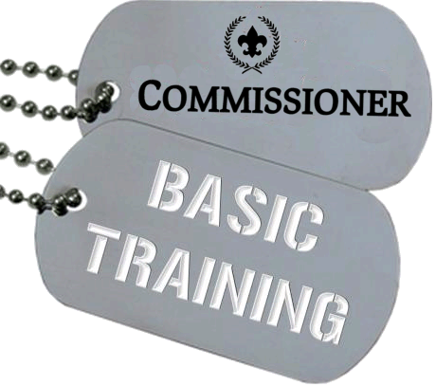
COMMISSIONER Training Updates
Sponsored by Area 7

Slide 14
COMMISSIONER Training Updates
October 4 – Sponsored by Area 3 8:30 AM 136 Sacred Heart Drive Monongahela, PA 15063
December 13 @ Flag Plazs – Area 2

Slide 15
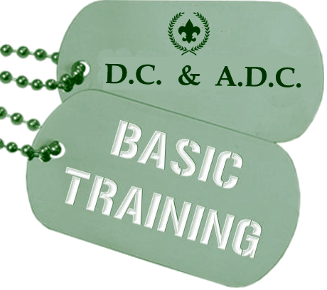
COMMISSIONER Training Updates
Should we hold one?

Slide 17
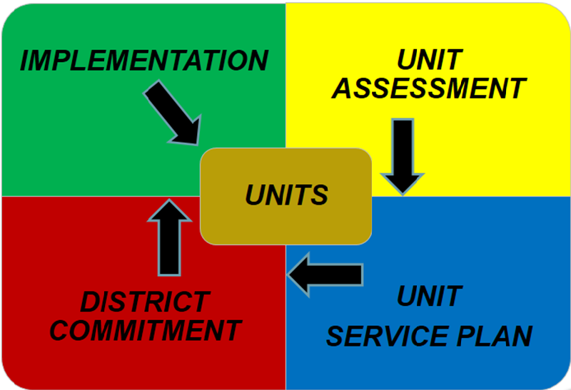
The Unit Service Plan

